Slide 1
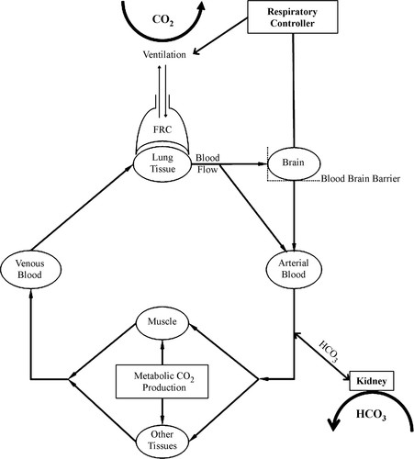
Hypercapnia and Sleep-Disordered Breathing: Research(es) In Progress
Brian Locke MD
PCCM Fellow; T32; MSCI, etc.
RIP 10/20/22
Notes:
Thoughts from presentation of this 10/20/22:
Utilize HCO3- and Serum potassium to increase se/sp of HCO3 screens?
Work needs to be done on tieing the data-driven approach back to clinical aims:
Usage of principal components… clustering within? Vs PCAs of Hypercap vs not
This is somewhat self-referential
Perhaps use this to try to tie back in to overall aims?
Maybe overkill on the amount of time discussing the problem
-> a gap in how our methods will solve the problem (we’re talking more about describing data… need to move toward normative assessments)
Consider completing this: what is your central message (1 sentence), what are we missing as a field? What should we be doing different? (We don’t follow the CO2 because we don’t know what to do with it - but monitoring will be ubiquitous and will add information about the degree of stress on the respiratory system and its ability to compensate.

Slide 2
Overview
Conceptual framing
Principle Components of EHR data for Identifying Hypercapnic Respiratory Failure: Brian Locke, Wayne Richards, Jeanette Brown, Krishna Sundar, Ram Gouripeddi
Other projects (rapid-fire, if time):
  Test Characteristics of HCO₃⁻ with various causes of hypercapnia: (same group)
  HCO3 Kinetics After OSA Dx and Treatment: Analisa Taylor, Brian Locke, Heather Howe, Kimberly Workman Krishna Sundar
  Factors predicting Central Sleep Apnea CPAP Trial vs. Likelihood of Success: Brian Locke, Jeff Sellman, Jonathan McFarland, Franscisco Uribe, Kimberly Workman, Krishna Sundar
  Burden of OSA Among Native Hawaiian Pacific Islanders: Brian Locke, Divya Sundar, Darin Riyujn
  Effect of Weight Loss Interventions on OSA Severity, SRMA: Brian Locke, Tee Nonthasawadrsi, Ainhoa Gomez Lumbreras, Nui Chaiyakunapruk

Slide 3
Research Motivation: Why OSA & CO2?
Epidemiologic Research on OSA and Hypercapnia is a quagmire
  Assessing degree of ’exposure’ to OSA is inaccurate: control groups often contaminated; AHI is not a reliable surrogate for severity
Deleterious consequences of OSA on ventilatory control are extremely plausible and modifiable
  Ventilatory control is malleable (breath hold divers, inspired CO2 studies)
  Except perhaps sleepiness, much more direct consequence than other OSA sequalae
  Why UT? Not as easily recognized at sea-level (yet; CO2 monitoring becoming commonplace..)
We have made progress reducing exposures for other lung disease (pollution, smoking), but we are not yet making progress on risks for ventilation control abnormalities (obesity, opiates)
Patients prone to ventilatory decompensation are not currently systematically identified or managed, and so frequently fall through the cracks. Identification and treatment of sleep disordered breathing and its risk factors is a promising approach to improve care but requires empiric support to justify implementation.
Notes:
Retrospective EHR-based research has a few key problems that have led to concerns about the reproducibility of the research and validity of conclusions:
Patient identification
Data quality / missingness
Time/Event determination (e.g. immortal time)
Observational nature (ie residual confounding; multiple comparisons)
Precise definitions (phenotypes) can help with patient identification (and possibly time/event determination if comparator group well defined?)

Slide 4


Principle Components of EHR data for Identifying Hypercapnic Respiratory Failure
Overall research hypotheses: Epidemiologic research on hypercapnic respiratory failure has been limited and hard to interpret. Reasons include:
  Reliance on EHR-based cohorts
  Suboptimal cohort definitions
  Conceptual ambiguity
EHR data can generate more useful findings if better patient identification methods (computable phenotypes) are used.

Slide 5

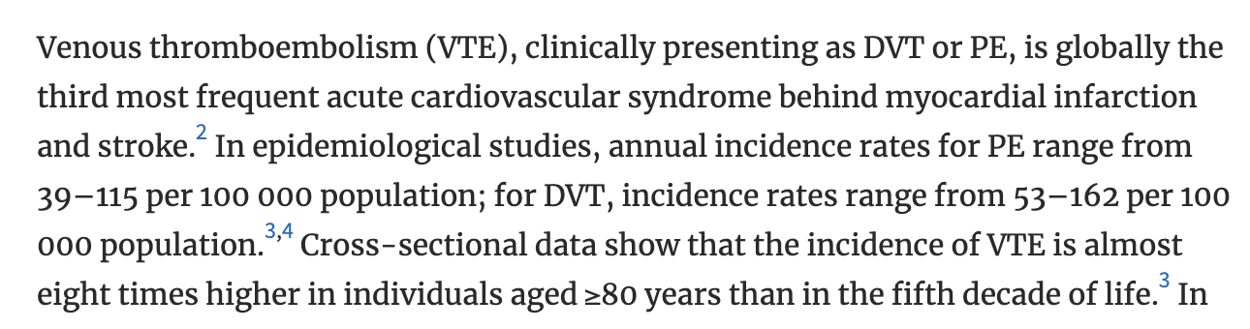
Chung Y, Garden FL, Marks GB, Vedam H. Population Prevalence of Hypercapnic Respiratory Failure from Any Cause. Am J Respir Crit Care Med. 2022 Apr 15;205(8):966-967.
Australia, 1 regional hospital services the district
Identified by initial ABG (w/n 24h) PaCO2 over 45, excluded iatrogenic causes/sedation. N=891 people, 1135 blood gasses (repeat hosp.)
Normalized rates of hypercapnia to population demographics
150 per 100,000 person/year.
Compared to Age 45-54:
RR 55-64: 2.1
RR 65-74: 6.2
RR 75-84: 15.7
RR 85-94: 26.2

Slide 6
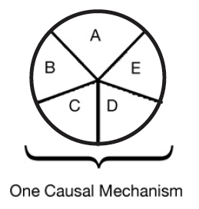
Multicausality
Hypothetical patient with hypercapnic respiratory failure
Sufficient cause: a set of factors that will cause disease when present
Component cause: a factor that, if not present, no disease would occur
  Necessary cause: in all sufficient sets, this component must be present
COPD
Obesity
Loop diuretic
Untreated
Sleep Apnea
Opiates
Notes:
“Perhaps the most important of these principles is self-evident from the model: A given disease can be caused by more than one causal mechanism, and every causal mechanism involves the joint action of a multitude of component causes”’
“The importance of multicausality is that most identified causes are neither necessary nor sufficient to produce disease. Nevertheless, a cause need not be either necessary or sufficient for its removal to result in disease
prevention. If a component cause that is neither necessary nor sufficient is blocked, a substantial amount of disease may be prevented."
Rothman and Greenland

Slide 7
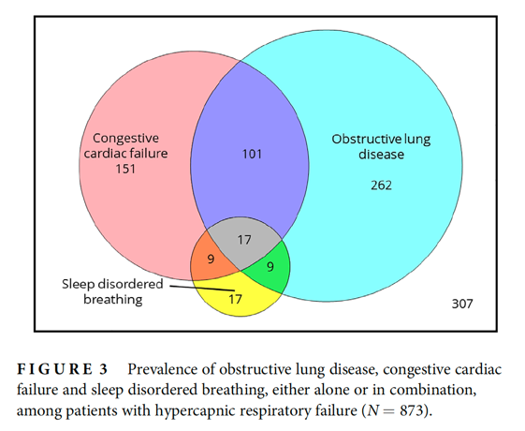
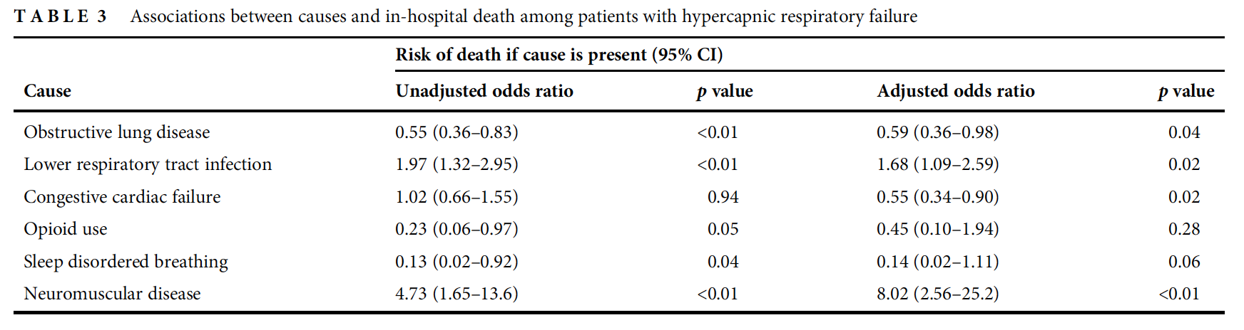
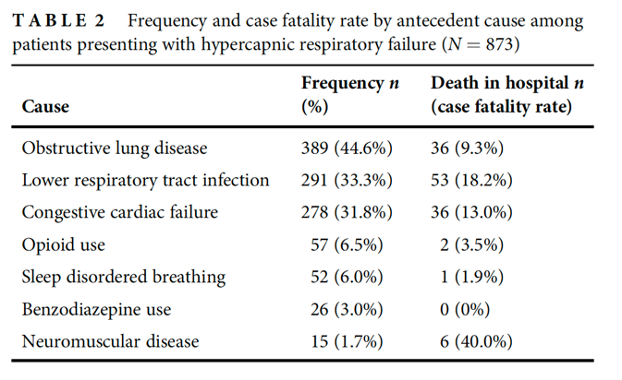
Chung Y, Garden FL, Marks GB, Vedam H. Causes of hypercapnic respiratory failure and associated in-hospital mortality. Respirology. 2022
Further analysis of same data
Diagnostic codes: 52% Charlson Comorbidity 5+
Overall in-hosp mortality 12.8%, 55% with acute acidosis
5% dx’d obesity; 6% dx’d OSA – not credible
Prevalence-based estimates: NMD under-represented
Notes:
DOI: 10.1111/resp.14388
Principal problem with epidemiologic research on OSA and hypercapnia – amount of missed diagnosis. And – if you include all those diagnoses, the population changers significantly.
52.4% had Charlson Comorbidity index above 5
6% having OSA is not believable. Unclear how accurate diagnoses are (e.g. Obesity in 5%?)
Believability of those conclusions suspect
The in-hospital mortality rate was 12.8%. Most (94%) deaths occurred in patients aged 55 years and over.
NMD are likely to be under-diagnosed in prevalence-based estimates (due to worse trajectory)
Acidosis in 55%
Registry-based outpatient NIV – “These studies are prone to selection bias and imprecise estimates for the prevalence of each cause due to exclusion of potentially relevant participants, especially if participants have been selected based on survival from their initial presentation”
We specified the following conditions as potentially directly antecedent to
the development of HRF: obstructive lung disease (including
COPD and asthma), SDB (obstructive sleep apnoea and
obesity-related hypoventilation syndromes), CCF, lower
respiratory tract infection, neuromuscular disease (including
chest wall disorders) and complications from opioid and/or
benzodiazepine use.
Although not typically associated with hypercapnia, systolic heart failure may lead to ventilatory failure by a number of mechanisms including dynamic airflow obstruction which resolves following the acute episode.16 Up to 44% of patients requiring ventilatory support for HRF have cardiac dysfunction and/or cardiogenic pulmonary oedema.1,3,17 and hypercapnia occurs in up to 58% of patients with acute heart
failure.18,19
[REVIEWED ELSEWHERE HERE] 1 Adler D, Pépin JL, Dupuis-Lozeron E, Espa-Cervena K, Merlet-
Violet R, Muller H, et al. Comorbidities and subgroups of patients surviving
severe acute hypercapnic respiratory failure in the intensive
care unit. Am J Respir Crit Care Med. 2017 Jul 15;196(2):200–7.
[ ] 3 - Çiftci F, Çileda g A, Erol S, Kaya A. Non-invasive ventilation for acute
hypercapnic respiratory failure in older patients. Wien Klin
Wochenschr. 2017 Oct;129(19–20):680–6.
[ ] 17 Contou D, Fragnoli C, C ordoba-Izquierdo A, Boissier F, Brun-
Buisson C, Thille AW. Noninvasive ventilation for acute hypercapnic
respiratory failure: intubation rate in an experienced unit. Respir Care.
2013 Dec;58(12):2045–52.
https://pubmed.ncbi.nlm.nih.gov/23737546/
[ ] 18 Aliberti S, Rosti VD, Travierso C, Brambilla AM, Piffer F, Petrelli G,
et al. A real life evaluation of non invasive ventilation in acute
cardiogenic pulmonary edema: a multicenter, perspective, observational
study for the ACPE SIMEU study group. BMC Emerg Med
[Internet]. 2018 Dec 29 [cited 2021 Feb 24];18:61 Available from:
https://www.ncbi.nlm.nih.gov/pmc/articles/PMC6310941/
[REVIEWED ELSEWHERE HERE] 19 Konishi M, Akiyama E, Suzuki H, Iwahashi N, Maejima N,
Tsukahara K, et al. Hypercapnia in patients with acute heart failure.
ESC Heart Fail. 2015 Mar 1;2(1):12–9.
Our value of 6.0% is most
likely an underestimate due to incomplete recording of the
diagnosis, a well-recognized issue with detecting sleep disorders
using medical records.22
[] 22
McIsaac DI, Gershon A, Wijeysundera D, Bryson GL, Badner N, van
Walraven C. Identifying obstructive sleep apnea in administrative
data: a study of diagnostic accuracy. Anesthesiology. 2015 Aug;123(2):
253–63.
Implication Future studies performed on patients who survive
an episode of HRF should also consider the potential
selection bias resulting from overrepresentation of patients
with chronic cardiopulmonary disease and underrepresentation
of neuromuscular conditions.

Slide 8
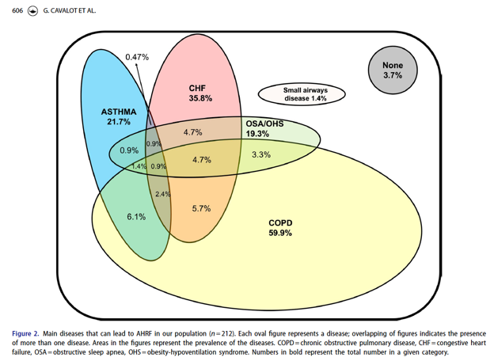
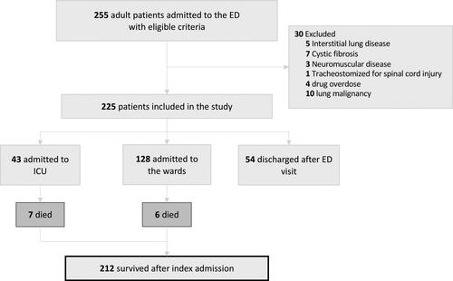
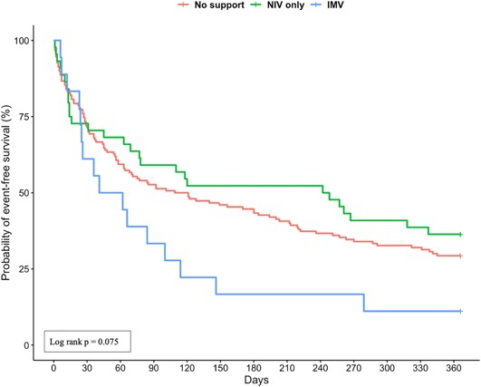
Giulia Cavalot, Vera Dounaevskaia, Fernando Vieira, Thomas Piraino, Remi Coudroy, Orla Smith, David A. Hall, Karen E. A. Burns & Laurent Brochard (2021) One-Year Readmission Following Undifferentiated Acute Hypercapnic Respiratory Failure, COPD: Journal of Chronic Obstructive Pulmonary Disease, 18:6, 602-611
All adult ED visits @ single Toronto ED w ABG <7.35/45+ OR VBG <7.34/50+ & CEDIS resp code for resp symptoms. Charts reviewed for 12 months.
Regression for risk of readmission: etiology not independently associated
Notes:
https://doi.org/10.1080/15412555.2021.1990240
At least 35% of patients in
our cohort had overlapping chronic diseases that likely
contributed to their hypercapnia

Slide 9
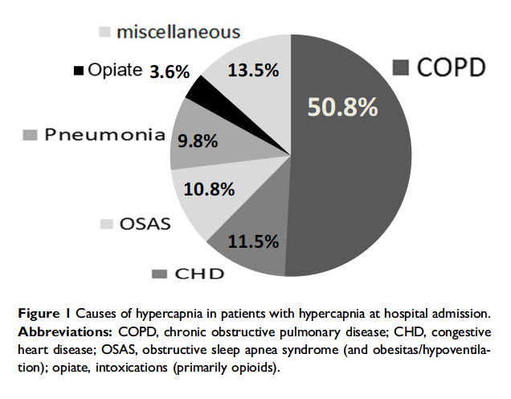
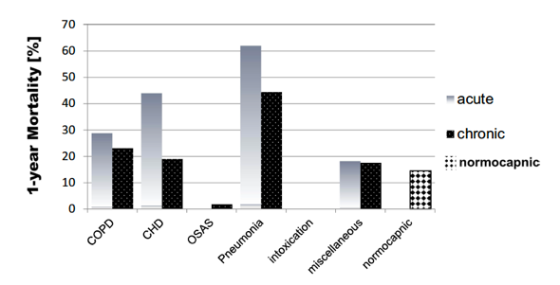
Vonderbank S, Gibis N, Schulz A, Boyko M, Erbuth A, Gürleyen H, Bastian A. Hypercapnia at Hospital Admission as a Predictor of Mortality. Open access emergency medicine : OAEM 2020; 12: 173-180.
All patients with dyspnea or pulm disease admitted to hospital received capillary blood gas (some screening with VBG). Stratified by pH > 7.35 or pH < 7.35
Hospital specializing in lung disease (unclear referral pattern): 6750 admissions, 2710 with dyspnea or lung dz, 1626 normocapnic, 588 hypercapnic.
32% 1yr mortality. Varied by type. Comparisons all seem very limited by collider bias.
Notes:
In terms of prediction of mortality:
The 1-year mortality rates of the hypercapnic patients with CHD or COPD were similar (28.4% and 24.6%, respectively), which were non-significantly higher rates than in the normocapnic\ controls (14.5%). Interestingly, the in-hospital mortality was significantly higher for the hypercapnic CHD patients than the hypercapnic COPD patients, at 19.4% and 7.5%, respectively.
Patients with untreated OHS have a significantly
higher risk ofmortality, as shown in a retrospective study that
reported that 7 out of 15 OHS patients (46%) who refused
long-term NIV died during the mean 50-month follow-up
period.19 Additionally, a prospective study by Nowbar and
colleagues20 explored the 18-month mortality rate of patients
with severe obesity and OHS (with daytime hypercapnia)
(n=47) after hospital discharge, only six (13%) of whom
were treated for OHS by NIVafter hospital discharge. They
found that the overall group of 47 had a significantly higher
mortality rate (23%) than the control patients (n=103) with
severe obesity alone (9%), who were well-matched for BMI,
age, and a number of comorbidities. The situation is quite different if the patients are treated
with NIV at home. Budweiser and colleagues21 conducted
a retrospective analysis of 126 OHS patients. Their 1, 2
and 5-year mortality rates were 3%, 8%, and 30%, respectively.

Slide 10
Possible use
https://jcsm.aasm.org/doi/full/10.5664/jcsm.9962
It seems like literature is coalescing on ABG – though with additional parameters.
[ ] need – clarify the interpretability of these?

Slide 11
Admissions with hypercapnia indicate high risk of morbidity; may be driven by treatable conditions
30d Readmission rate: 23% (2/3 recurrence)
~= CHF. > than MI, AECOPD, PNa
Admitted (ICU or floor) with one of the following diagnostic codes:
J96.02 (acute hypercapnic respiratory failure)
J96.22 (acute and chronic respiratory failure with hypercapnia)
J96.92 (respiratory failure unspecified with hypercapnia)
J96.12 (chronic respiratory failure with hypercapnia)
E66.2 (morbid obesity with hypoventilation)
Admitted to hospital (Floor or ICU) with ABG showing PaCO2 over 45 mmHg and pH 7.35-7.45
 | COPD (2/3) | No COPD (1/3)
AHI Median [IQR] | 31.9 [14.3, 45.6] | 66.0 [48.0, 83.8]
AHI > 5 present | 66% | 94%
AHI > 15 present | 51% | 81%
1. Admitted to the ICU
2. PaCO2 greater than 47.25 mmHg
3. Procedure code for non-invasive ventilation or invasive mechanical ventilation initiation
Notes:
Exclusion of other causes of hypoventilation
Obesity -> increased CO2 production and vent limitation from mass of chest wall and disadvantaged respiratory mechanics
“Other Causes”: Obstructive lung disease, neuromuscular / chest wall disease, things that suppress ventilatory drive (opiates), or causes of metabolic alkalosis (loop diuretics)
Likely routine to you all, but this is often botched in pulmonary and inpatient medicine.
Exclusion parameter
In research studies: A patient with mild COPD cannot have OHS. In reality – what do you do with a patient who has COPD so mild that it doesn’t cause OHS? Or, if it’s mild enough that it wouldn’t cause hypercapnia on it’s own? Open questions, problem with the paradigm.
“Exclusion of other causes of hypoventilation
Severe obstructive respiratory disease
Severe interstitial lung disease
Severe chest-wall disorders (eg, kyphoscoliosis)
Severe hypothyroidism
Neuromuscular disease
Congenital hypoventilation syndromes”

Slide 12
Why not just use PaCO2 > 45 mmHg?
ABGs are infrequently obtained
  People who get ABGs are different from people who don’t.
  If you only include people who get confirmatory ABG, you will both miss many patients, and get an unrepresentative sample.
Study design 101:
  To test interventions: homogenous group, high risk of the outcome, likely to respond similarly to intervention
    Requiring PaCO2 > 45 (or 52) mmHg not a problem
  To understand incidence/prevalence, and improve processes of care: sensitivity of your criteria matter
    Classic risk factors, unambiguous presentation, and severe disease over-represented: ↑ P(ABG obtained)
    Underestimate (total) burden, oversimplify population, exclude patients that might benefit
  To understand prognosis: variations in P(ABG obtained) matters
Notes:
TODO: figure to represent distribution of comorbidities?
or, in critical care – you include everyone and the trials are negative.. But that’s a separate issue
Better operational defintions:
How common is hypercapnic respiratory failure?
Inability to estimate burden - is it increasing?
What should patients with hypercapnic respiratory failure expect?
Unable to identify and prioritize treatment needs – who do we know how to treat? Who should we figure out how to treat?
CO2 retention (hypercapnia) results from inadequate alveolar ventilation relative to metabolic rate
‘V̇A, the volume of gas mobilized in the lungs, per unit of time, contributing to the pulmonary gas exchanges’
‘Ventilatory failure occurs when respiratory muscle capacity is reduced, the load on respiratory muscles is increased or central drive is reduced.’

Slide 13
What is ‘hypercapnic respiratory failure’?
Problems with PaCO2 > 45 mmHg (sea-level, current def)
  97.5 Percentile of ‘normal’?
  “Hypercapnic respiratory failure is a syndrome”; PaCO2 = Lab finding (hypercapnia). Gap?
    Syndrome (Greek: ‘con-currence’) = a set of signs and symptoms that together suggest a common cause.
    If there is no agreed-upon reference standard test: perhaps ‘construct’ is a better term.
  ‘Ventilatory Failure’: can the respiratory system meet the body’s demand
    Is a patient with OHS (‘submissive hypercapnia’) meeting the body’s demand?
  2 instrumental uses: Classification: “Hyperlipidemia” vs Prediction: “10-y ASCVD risk”
    Predicting future risk of ventilatory failure: ‘ventilatory frailty’ (prognosis)
    Predicting differential treatment response (management)
Ideal Definition: Who is at risk for future/ongoing ventilatory failure? Who will respond to treatments?
Notes:
What is our ‘reference standard’?
2. The test is not the truth (Scott’s post - https://www.statusiatrogenicus.com/2019/05/the-test-is-not-truth-one-week-in-life.html)
3. ‘Construct’ of ventilatory failure? (=gives shared language to understand)
4. Classification vs Prediction tasks.
‘Severe and persistent hypercapnia, termed hypercapnic respiratory failure, is defined as
chronically high PaCO2 (>45 mmHg) [5].’
Budweiser S, Jörres RA, Pfeifer M. Treatment of respiratory failure in COPD. Int J Chron Obstruct Pulmon Dis
2008; 3: 605–618.
—> interesting to note that there is usually no specification on how long “persistent” is required to be.
The word “syndrome” (from Greek language:
συν-δρóμος meaning “con-currence”) denotes a clinical presentation of different phenomena that together invoke a common cause on which the eventual diagnosis is established. However, this expression may introduce a bias when a cause is inferred but cannot be proven.
Causal inference may be spurious when clinical manifestations are non-specific, as in OSA. In that case, a gold-standard reference test is needed to demonstrate that the presumed cause is present. If such a test is not available, the “syndrome” definition has no solid foundation and the disease construct may be nothing more than a black box.
There is a risk of lumping conditions it should be lumped. Which could be a hindrance to discovering how to manage individual patients. However I would argue that even if that is the case, lumping the syndrome together can be very helpful to improve recognition processes of care. As an example how it operates sepsis, which in the last 30 years of research has not healed any strong evidence positive recommendations, but it’s been huge benefit for improving processes of care.
Is it an epiphenomema? How does this relate to syndrome vs disease?
‘Construct’ of ventilatory failure? (=gives shared language to understand
Classification: e.g. you have high cholesterol or not?
Prediction: e.g. your risk of ASCVD in 10 years is __? –ARR warrants statin
A prediction-based construct: better for clinical care and trials, more slippery
What would we be predicting? Abstrct: future respiratory failure. Operational: death, readmission, or activity limitation from ventilatory respiratory failure
“The majority of ML applications in medicine are still using classification 8 methods rather than risk prediction. It is time for researchers to realize that classification provides limited information, is arbitrary, is more prone to patient sampling issues, and is at odds with medical decision making.” From https://discourse.datamethods.org/t/observations-on-big-data-precision-health-and-machine-learning/6061
Example of PFTs: attempting to move toward
Place to take this? Prospective definition vs cross sectional definition of hypercapnia as per here https://www.atsjournals.org/doi/full/10.1164/rccm.202204-0628LE
Define hypercapnia in terms of the increased risk of morbidity (like pHTN).
Consider Framingham as a prediction that usurps the diagnosis of HLD. Analogous concept of prediction of respiratory frailty?
Is “Hypercapnic Respiratory Failure” too heterogenous to study?
Studying ’syndromes’ haven’t been particularly fruitful
Proposed paradigm -> moving toward precision in defining the heterogeneity: will it be based on physiologic, epidemiologic, microbiologic criteria?
https://www.nature.com/articles/s41591-022-01843-x#Fig1
“The capacity to oxygenate and ventilate actively metabolizing tissue depends
upon three key factors: prudent regulation, reserve capacity, and tissue adaptability
to any sustained shortfall” Marini DOI: 10.1097/CCM.0000000000005022
Servo control = automatic control system that takes a mechanical position or angle as the control object.
https://www.nature.com/articles/s41591-022-01843-x#Fig1 –
Argue to separate syndromes into:
Insult that can possibly lead to the syndrome: what is the physiologic disturbance?
Treatable trait: physiology identifiable by biomarkers (or other identifiable features) that predicts response to treatmen
Requires trials that enroll on the basis of treatable traits.

Slide 14
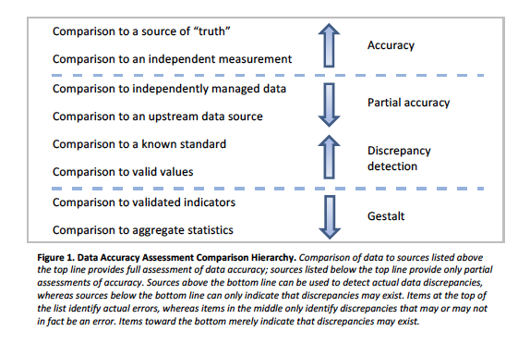
Why not just use PaCO2 > 45 mmHg?
Criteria for a good definition:
  Reliable (identifies only & all) –
    Bayes: P(Pre-test) ↑ : Required strength of evidence ↓ for same P(Post-test)
  Feasible (usual data elements) – ABGs frequently not obtained; HCVR, MVV...
  Valid (truly measures what we’re interested in)
    Possible to have PaCO2 < 45 and not meet bodies demand (e.g. metabolic acidosis)
    Possible to have ‘hypercapnic success’ (e.g. metabolic alkalosis, submissive hypercapnia)
    People who have high risk of future/ongoing death, readmission, or activity limitation from ventilatory insufficiency have the criteria. People with low risk do not.
Consensus…
Notes:
From NIH Collaboratory: ” Assessing Data Quality for Healthcare Systems Data Used in Clinical Research "
Is hypercapnia a syndrome? (Vs a construct: ventilatory failure)
When there is no reference standard for a construct: framework to define should (from DOI: 10.1164/rccm.202206-1048CP) [ ] this would also be a good place to start
‘According to Binning, a construct is “derived from the general scientific process: observing natural phenomena, inferring common features, and constructing a label for the observed commonality or the underlying cause of the commonality” citation 22. Construct is useful if people think about it similarly (thus, requires CONSENSUS). Diagnostic criteria should be evaluated as instruments to measure a construct.
What is the clinical phenomenon that warrants capture?
The construct is that ventilation is no longer meeting the patient’s needs.
— prognosis is probably importantly effected by how powerful the derangement in the need.
— really 3 groups: big need, poor respiratory system, and poor control (which both manifests as rhythm generation failure or ventilatory response failure)
Lumpers vs Splitters with respect to purposes of syndromes.
Be structured around reliability, feasibility, and validity
Reliability - Always identifies pt; intra and inter-observer agreement. - e.g. Work of breathing? Esophageal probes
Feasiblity - complexity, time, cost, consequences of FN and FP. e.g. ABGs are not widely obtained so we have many false negatives - if accurate, a better definition should include other sources.
Validity - does it measure what it says it measures?
— face validity: assessed by a Delphi method or Nominal group. Hypercapnia fails on: Isolated blood gas fails on two counts: ignoring load and control.
— predictive validity —> similar to HLD being supplanted by ASCVD risk - does it have prognostic importance? Does it identify patients that benefit from certain tests or treatments?
Tests of validity: follow the form - if you have hypercapnic RF [ x ] should be present, and if you don’t, you should not have [ x ]; ideally with dose (severity) response relationship.
— tests based on response to treatments are problematic because most treatments fail in RCTs, and furthermore most treatments don’t work on most individuals.
Definition should contain:
Purpose: identify patients who have an imbalance between their CO2 production, ventilation, and gas-exchange; or a problem with ventilatory control - interestingly vague; and the difference in mechanism leading to the same manifestation certainly has importance for prognosis and management. However, can these cleanly be separated? Are there tests to differentiate can’t from won’t breathe?
Methodology
Framework for empirically testing any definition
Purpose, we need ways to enroll patients in studies for prognostic and therapeutic purposes ( and to more toward shared understanding of how to identify and manage these patients in clinical practice.
Ventilatory failure:
-It is possible to have hypocapnia, yet not meet what the body demands
-It is theoretically possible to have “hypercapnic success” in response to metabolic alkalosis.
Ideally you’d want things like:
‘Understanding ventilatory neural drive is useful when studying
respiratory diseases, providing information on the efficiency of the ventilatory pump, when used in
conjunction with mechanical outputs such as volume and flow.’
‘Measurement of diaphragmatic activation using EMG is especially important in patients with mechanical
constraint, given that the inaccuracy of approximating ventilatory neural drive from respiratory output
(using variables such as minute ventilation) is exacerbated in these patients, who often exhibit higher levels
of disconnect between drive to breathe and ability of the respiratory muscles to respond, known as
neuromechanical uncoupling’
Purpose:
In order to maximize the sensitivity of epidemiologic research, defining cohorts at high risk, homogenous treatment response -> maximizes the chance of finding effects, which can then be generalized to others.
In that case, it makes sense to chose very restrictive definitions, exclude competing etiologies.
However, for research to clarify the impact of the problem, refine definitions/diagnostic criteria, characterize the gaps in knowledge, and figure out how proposed management changes will influence clinical practice and improve care processes, you want to characterize all patients with the ‘syndrome’.
Worth considering that it’s more of a finding than syndrome- given that the definition is predicated on a single lab value, and not a constellation of signs or symptoms. (Ventilatory failure is more the syndrome, encompassing some measure of allostatic load; resistance to perturbations, respiratory control system function and frailty)
What I’m proposing is is that we don’t know the implication of the finding - what might have caused it, what should we do, what should we expect without treatment.
—> this is a different type of epidemiology: an epidemiology that’s not targeted toward improving knowledge or public health - but an epidemiology that targeted toward improving medical practice.

Slide 15
Review: Common Methods of Identifying Hypercapnic Respiratory Failure Produce Meaningfully Different Cohorts
Brian Locke, Krishna Sundar, Jeanette Brown, Ramikiran Gouripeddi
69 Million MRNs aggregated from 50 academic medical centers
Deidentified patient level data, including admissions, diagnoses, medications, procedures, and lab values.
Missing data?
Hypothesis 1: The methods used in prior studies of hypercapnic respiratory failure (billing code-, procedural code-, and blood-gas-based criteria) identify different patients.
  Outcome: Relative Sensitivity; Positive Predictive Agreement
Hypothesis 2: The cohorts created by these differ methods differ in risk for outcomes of interest, which hampers interpretation of these studies.
  Outcome: distribution of age, ethnicity, BMI, and frequency of coexisting diagnoses (OSA, opiate use disorder, COPD, CHF, and neuromuscular disease)
Notes:
Exclusion of other causes of hypoventilation
Obesity -> increased CO2 production and vent limitation from mass of chest wall and disadvantaged respiratory mechanics
“Other Causes”: Obstructive lung disease, neuromuscular / chest wall disease, things that suppress ventilatory drive (opiates), or causes of metabolic alkalosis (loop diuretics)
Likely routine to you all, but this is often botched in pulmonary and inpatient medicine.
Exclusion parameter
In research studies: A patient with mild COPD cannot have OHS. In reality – what do you do with a patient who has COPD so mild that it doesn’t cause OHS? Or, if it’s mild enough that it wouldn’t cause hypercapnia on it’s own? Open questions, problem with the paradigm.
“Exclusion of other causes of hypoventilation
Severe obstructive respiratory disease
Severe interstitial lung disease
Severe chest-wall disorders (eg, kyphoscoliosis)
Severe hypothyroidism
Neuromuscular disease
Congenital hypoventilation syndromes”

Slide 16
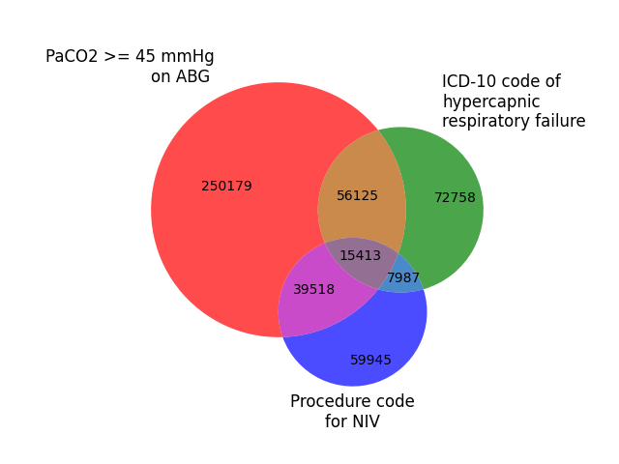
Common Methods of Identifying Hypercapnic Respiratory Failure Produce Meaningfully Different Cohorts
Brian Locke, Krishna Sundar, Jeanette Brown, Ramikiran Gouripeddi
Preliminary Results
ICD Group:
Relative sensitivity (vs ABG): 19.8%
Positive Predictive Agreement (vs ABG): 47.0%
NIV Group:
Relative sensitivity (vs ABG): 15.2%
Positive Predictive Agreement (vs ABG): 45.2%
Notes:
Why start with inpatients with Hypercapnia?
Easier ascertainment
Informed presence bias
Labs
Data sources
Higher morbidity

Slide 17
Common Methods of Identifying Hypercapnic Respiratory Failure Produce Meaningfully Different Cohorts
Brian Locke, Krishna Sundar, Jeanette Brown, Ramikiran Gouripeddi
 | ABG Group | ICD Group | NIV Group
Age | 62±18 | 65±16 | 62±17
% Female | 46% | 51% | 42%
% white | 66% | 71% | 65%
% Black | 18% | 19% | 17%
BMI | 30.4±8.3 | 33.1±10.3 | 29.1±8.2
% with CHF | 37% | 30% | 19%
% with COPD | 31% | 30% | 14%
% Opiate UD | 6% | 3% | 3%
% Sleep Apnea | 23% | 24% | 10%
This is a vague description and doesn’t encapsulate data about how they decompensated at time of Hypercap. RF
How could we do better?

Slide 18
Principle Components of EHR data for Identifying Hypercapnic Respiratory Failure: Study Aims
Currently, all research on hypercapnic respiratory failure focuses on isolated consideration of 3 types of data: Lab Results, Comorbid Conditions and Outcomes
There are features we know are of interest medically that are not captured in current definitions or descriptions
  High vs low drive to breath
  Patterns of comorbidities
  Patterns of management
Gap: Is there enough data in EHRs to make good guesses about who has hypercapnic respiratory failure when PaCO2 not measured?
  If you were going to propose ways to identify or characterize patients with hypercapnic respiratory failure in EHR data, what features would you use?
Notes:
What relevant data elements are captured and infer-able from EHR?
Improve the methods of identification and classification of hypercapnic respiratory failure to allow proper characterization***
Subaim 1: Describe how current methods perform
Subaim 2: Understand the structure of EHR data in identifying and describing patients with hypercapnia
Subaim 3: To extend methods to estimate the overall burden of hypercapnic respiratory failure.
Can information in datasets such as Hospital Readmission Index (no ABG) be used to accurately identify Hypercapnia to estimate nation-wide burden?
Subaim 4: to characterize component causes (comorbidome) of hypercapnic respiratory failure

Slide 19
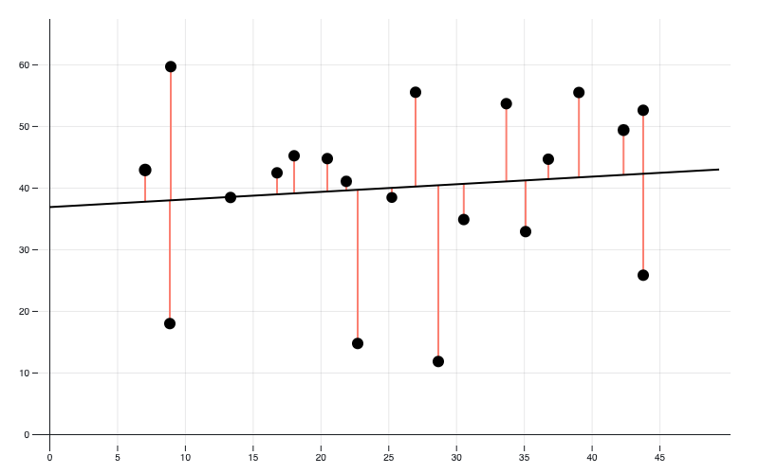
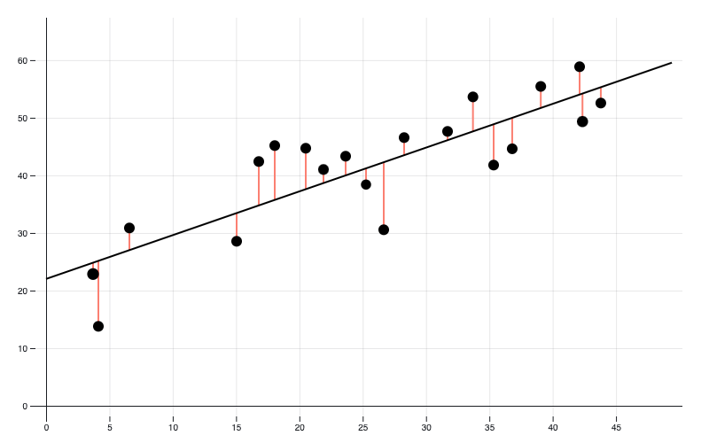
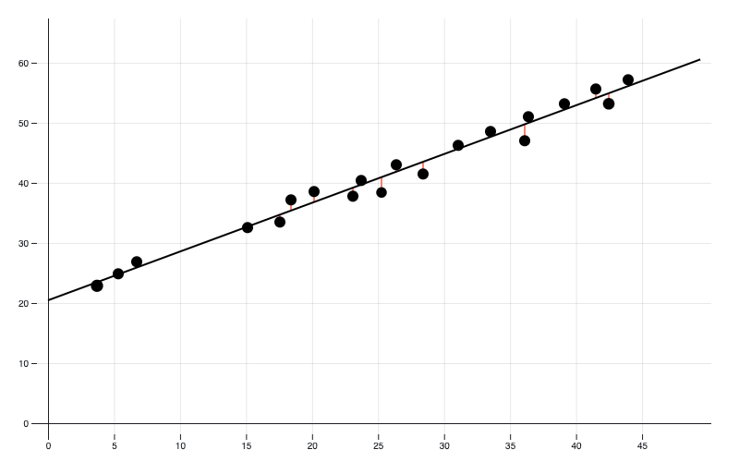
Methods: Principal Component Analysis
*ANOVA meaning
Modeling and explained variability: linear regression
R² (Percentage of variation explained) = 0.01
R² (Percentage of variation explained) = 0.70
R² (Percentage of variation explained) = 0.98
Notes:
https://observablehq.com/@yizhe-ang/interactive-visualization-of-linear-regression
[ ] generate QR code

Slide 20
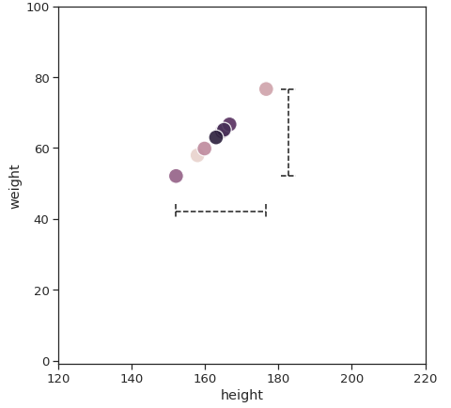
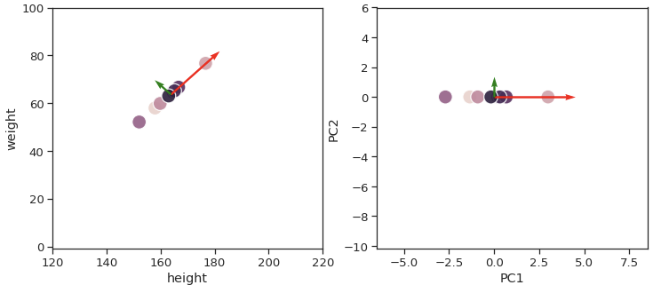
Methods: Principal Component Analysis
Height vs Weight
Perfectly correlated: if you know height, you know the weight.
  R² = 100%
  You only need to know 1 value to describe each data point
Notes:
https://towardsdatascience.com/principal-component-analysis-pca-explained-visually-with-zero-math-1cbf392b9e7d

Slide 21
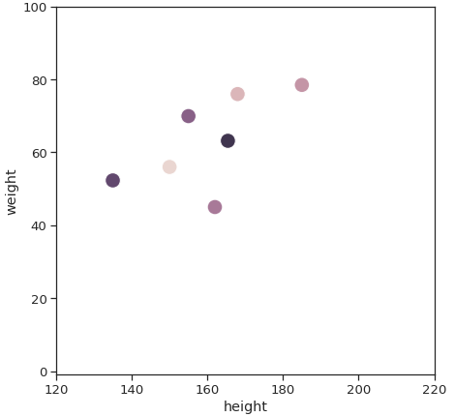
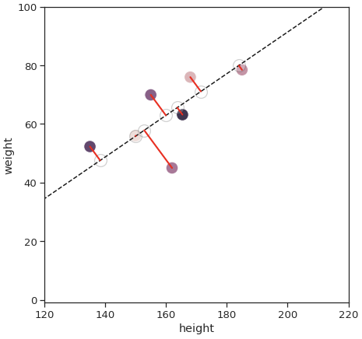
Methods: Principal Component Analysis
Notes:
https://towardsdatascience.com/principal-component-analysis-pca-explained-visually-with-zero-math-1cbf392b9e7d
“This means that ‘preserving as much variability as possible’ translates into finding new variables that are linear functions of those in the original dataset, that successively maximize variance and that are uncorrelated with each other.”

Slide 22
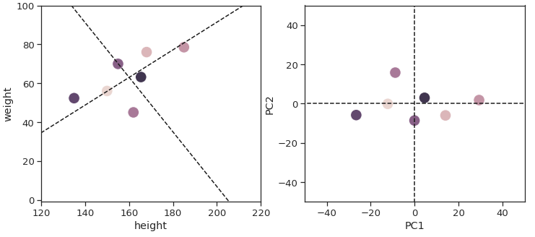
Methods: Principal Component Analysis
PC1: Skeletal size
PC2: Soft tissue size
Notes:
https://towardsdatascience.com/principal-component-analysis-pca-explained-visually-with-zero-math-1cbf392b9e7d

Slide 23
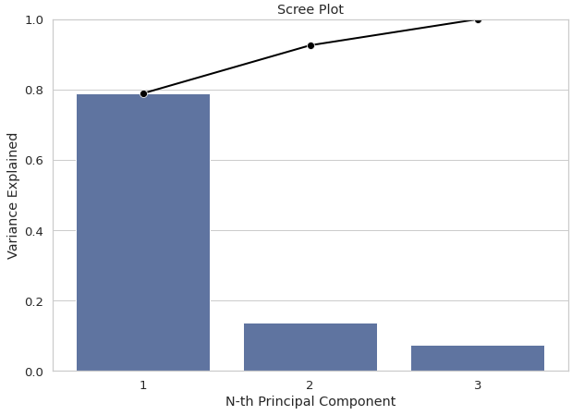
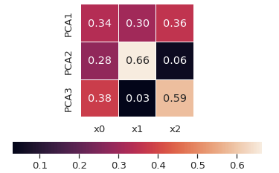
Methods: Principal Component Analysis
PC1: Explains the most variability
PC2: Explains the next most
(This is a data transform. NO CLAIMS MADE)
PC1: Skeletal size
PC2: Soft tissue size
(This is a story I made up, it is a claim)
Notes:
https://towardsdatascience.com/principal-component-analysis-pca-explained-visually-with-zero-math-1cbf392b9e7d

Slide 24
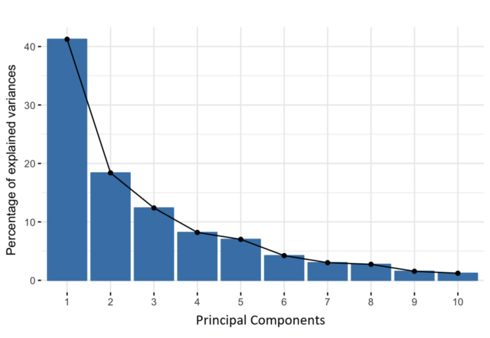
Methods: Principal Component Analysis
Dimension Reduction
  ‘High dimensional data’: many characteristics (100s) on many data points (100,000s)
    Genetic analyses, ‘-omics’
    Complex signals (e.g. PSG data)
    EHR data
  Problematic for 2 reasons:
    Computationally hard to run analyses
    Statistically, inadvisable to run analyses (overfitting)
Application: if you want to summarize the ways data points vary, but using the minimum number of characteristics
  What variables are most informative in linear combination, for our purposes? (data description)
  From data not physiology: no guarantee the pattern represents a ‘physiologic’ thing
Notes:
Presentation of data: = maintain the information in the data represented in the minimum number of axes
Eg. “PC1 consisted mostly of hernia dimensions, with HV demonstrating a 56% correlation, HV:IAV 46.2%, and defect area 43.2%. PC2 consisted of primarily SQV (66.0%) and BMI (56.6% correlation).” DOI 10.1007/s00464-019-06703-3
PCA uses: [ ] do more literature searches for healthcare uses.
Genetics
‘-omic’ analyses
??? Not much for computable phenotypes, yet!
[ ] Computable phenotypes and critical care, respiratory failure, etc.
[ ] PCA and the above

Slide 25
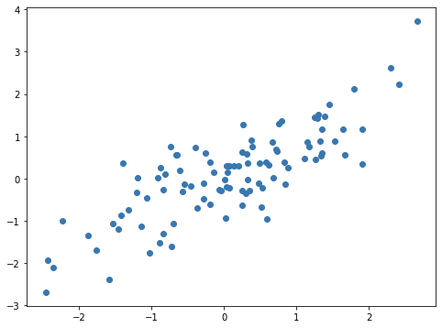
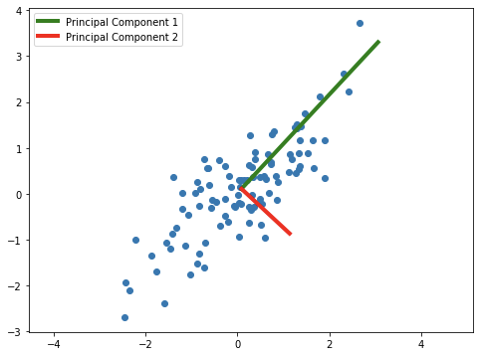
Methods: Principal Component Analysis
Hypothetical Data: Serum [HCO3-] vs PaCO2
PC1: Degree of (Acute) CO2 retention
PC2: Degree of Metabolic Compensation
Notes:
References: https://www.youtube.com/watch?v=FgakZw6K1QQ&t=101s
Sources of HCO3 variability outside Ve response - DOI: 10.1080/10408363.2019.1568965
Women: menstrual cycle – PaCO2 drops 3 mmHg during luteal cycle; SBE drops 2 mmol/l
Gas in the syringe / preclinical issues (e.g. time for leukocytes to metabolize)
Alkaline tide after a meal
Finally, since blood-gas analyses are sensitive to many
preanalytical variations, 5 measured venous bicarbonate
concentration would probably be an interesting alternative
for early-OHS screening
---Baird G . Preanalytical considerations in blood gas analysis . Biochem
Med (Zagreb) . 2013 ; 23 ( 1 ): 19 - 27 .

Slide 26
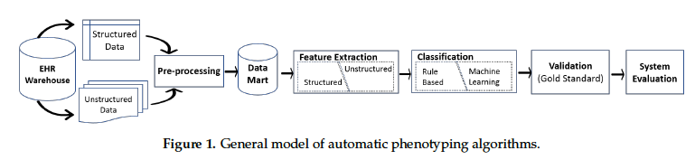
Aim: Identify the principal components among patients with Hypercapnic RF
Why?
  If only a few data axes describe most the variability, computational phenotypes without a reference standard will be harder
  Allows us to understand which types of features vary between patients with hypercapnic RF
    Assess differences between currently used methods of identification
    Propose features to use in better identification methods
  Principal components would be used for inputs into, clustering algorithms / Classifiers (i.e. ‘machine learning’)
Notes:
Ram advice [ ] this is a data driven way to describe (e.g. model) the variability in the data as linear combinations
Electronics 2019, 8, 1235; doi:10.3390/electronics8111235

Slide 27
Aim: Identify the principal components among patients with Hypercapnic RF
Patients: Met ICD code, ABG, or Procedure code-based definition for hypercapnic respiratory failure during 1st admission.
Method: Generate and operationalize a list of candidate features
  Demographics (Age, Sex, Ethnicity/Race)
  Lab Test (ABG, VBG, BMP, Hgb, LVEF)
  Diagnostic codes during the admission (e.g. Heart Failure I50.*, Status Asthmaticus (J46.*), Guillain-Barre(G61.*), etc. etc.
  Procedures (NIV, IMV, Nerve Conduction Studies, Inhaler Teaching, CXR, Critical Care Services, etc.)
  Prior Diagnoses (OSA G47.3, Dementia F01-9.*, Spinal Cord Injury G95)
  Inpatient Medications (Corticosteroids, Naloxone, Bronchodilators, Diuretics)
  Prior Outpatient Medications (Opiates, Diuretics)
  Vital signs (first recorded RR-14, recorded BMI-22, etc.)

Slide 28
Preliminary Results:
Dataset: 925,512 patients from 70 Healthcare organizations since 2017. 20 gb of data.
  1.2 Billion ‘facts’ in medications alone.
  Center for High Performance Computing protected environment
Limited ”test data” set with ~100 mb worth of data (sparse)
  Test scripts prior to main run in coming weeks.

Slide 29
Preliminary Results
Most common dx’s Pneumonia, Dyspnea NOS, AECOPD, Long term use of opiates
Most common procedures: Xray, CPAP, treatment with inhalers
Most common pre-existing: Dementia, OSA, Secondary Polycthemia
Inpatient medications: Steroids > Narcan > Vasodilators
Outpatient medications: Opiates > Loop diuretics > bronchodilators > muscle relaxers.

Slide 30
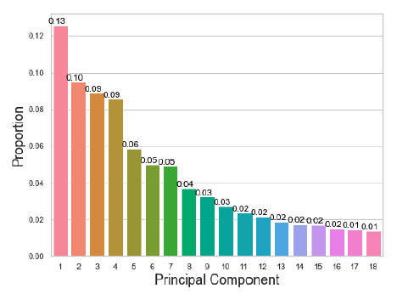
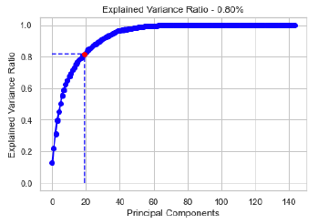
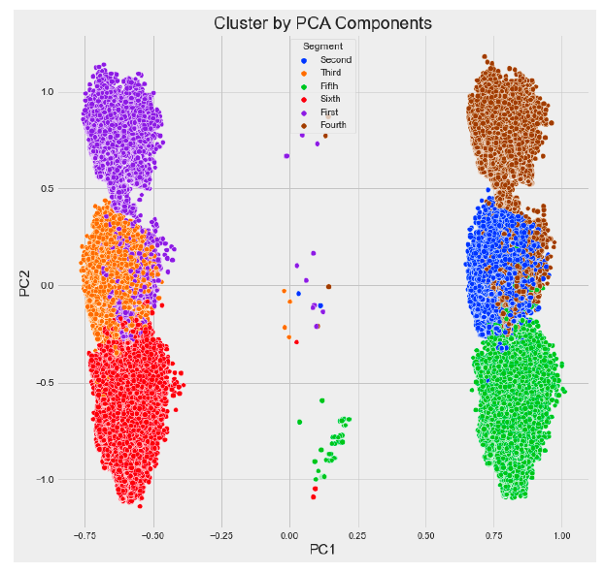
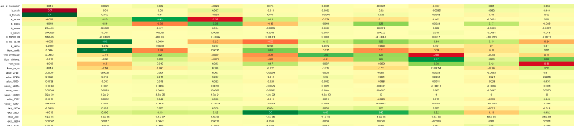
Preliminary Results

Slide 31
Next steps:
Further proofreading that our encoding/capture of data features is accurate.
Run the PCA on the full dataset and evaluate whether (or not) there are physiologic correlates to most important principal components
Evaluate whether the patients identified by the 3 epidemiologic methods in current use (ABG, procedures, dx-based) differ based on the principal components

Slide 32
Issues: inferences from data
Research degrees of freedom:
  What candidate features do we include? How do we represent them?
Do principal components correspond to helpful things? Could you test it?
  If you did it on a slightly different data-set, would you find the same thing?
  Would they persist through time? Do people you expect to have certain features have them?
Big Data: ~roughly 1/4 of all people with hypercapnic RF in the USA
  Aus prevalence (150 per 100,000 per year = 500,000 people with hypercapnia in USA per year)
  “Which one should I trust more: a 1% survey with 60% response rate or a self-reported administrative dataset covering 80% of the population?” Xiao-Li Meng. Depends on 3 things
    Data quality measure: how non-random is the data included
    Data quantity measure: how much of the population of interest is in the dataset
    Problem difficulty measure
Notes:
150 per 100,000 person/year.
* 350 million = 150*3500= 525,000 cases per year.
2 graphs of patients, PaCO2 vs HCO3
They will be correlated - by degree of acute hypercapnia
There will be some variation around this line. That variation will be, roughly, compensation.
You can decompose this into two axes - > this does not involve a hypothesis. Just a data transformation.
Labeling of CO2 level and chronicity is a hypotheses that comes from outside the data.
Ideally, you’d like to test that the labels you apply have some validity: (ie. Do people who you expect to have high PC1 have high PC1? People who don’t, don’t?
https://royalsocietypublishing.org/doi/10.1098/rsta.2015.0202
Issues with clustering analyses: https://doi.org/10.1016/S2213-8587(18)30124-4
—> clusters do NOT necessarily indicate subgroups in the data. Instead, they demonstrate dependency of variables (ie. There will always be clusters unless the variables are completely unrelated)
“reduces the complexity of datasets while preserving data covariance”
=> if claiming this represents subgroups, should reference theory (pre-existing) for why the dependencies in the data have meaning.
=> since we always see patterns, clustering THEN explaining is less convincing then predicting what patterns you’ll see
“For example, we might reasonably expect within-cluster patient heterogeneity, which could be studied by relating patients' distance to the cluster centres or posterior probabilities of cluster membership to outcomes.”
—
Stability of clusters through time? https://twitter.com/athattersley/status/1572515692427247618?s=11&t=YV15r_TInrkj7qQ74IjG1w
Paper: “Reviews and Commentary
CONCEPTUAL PROBLEMS IN THE DEFINITION AND INTERPRETATION OF ATTRIBUTABLE FRACTIONS”
Attributable risk aka attributable fraction aka etiologic fraction aka attributable portion
2 interpretations:
Did the exposure play an etiologic role
Without the exposure it would not have occurred. (Implies etiologic role, but more specific)
Attributable fraction measures only the second. Important to get a sense what proportion the first are: e.g. exposure made the case occur earlier than it would have
distinguish three conceptsof attributable fraction: the excess fraction, the etiologic fraction, and the incidence density
fraction. (<- incidence density = hazard)
Analagous concept that may be useful: the susceptible proportion (proportion of persons susceptible to exposure-induced disease)
Do the patterns you find mean anything? To the extent that they don’t represent known physiologic phenomena, it’s less likely.
However, consider that we don’t have ways to identify most of the physiologic phenomena that we know about currently
Relavent parameters: respiratory drive, respiratory effort, reserve, ventilatory load, etc.
One critique of phenotyping (whether sepsis, ARDS, etc.) is that it leads to identifying spurious noise. However, the inability to split patients into ‘diagnoses’ that either predict outcome or predict treatment response
Is the EHR data-source rich enough to support these inference? Not sure – have to try to find out.
Hypothesis of the research: there is sufficient granularity in the data in the EHR to tell us useful things about biology.

Slide 33
Thoughts?
Future Aims:
  Include patients without hypercapnic respiratory failure and define the principle components that differ between patients with with w/o hypercapnic RF
  Evaluate which features correlate with readmission risk or mortality risk*
  Generate a reference standard dataset to test performance of various enrollment criteria**
  Use the TriNetX database to develop a classifier that uses features available in the NCUPS National Readmission Database (comorbidities, diagnoses) to identify hypercapnic respiratory failure (by traditional criteria), then apply for estimate of nationwide readmission burden (rates, costs).
Notes:
Would a random forest classifier be the right approach here? (data hungry – but we have data)
Data reduction -> regression model (= hard to interpret, but works)

Slide 34
Rapid Fire Round
Test Characteristics of HCO₃⁻ with various causes of hypercapnia: (same group)
HCO3 Kinetics After OSA Dx and Treatment: Analisa Taylor, Brian Locke, Heather Howe, Krishna Sundar
Factors predicting Central Sleep Apnea CPAP Trial vs. Likelihood of Success: Brian Locke, Jeff Sellman, Krishna Sundar
Burden of OSA Among Native Hawaiian Pacific Islanders: Brian Locke, Divya Sundar, Darin Riyujn
Effect of Weight Loss Interventions on OSA Severity, SRMA: Brian Locke, Tee Nonthasawadrsi, Ainhoa Gomez Lumbreras, Nui Chaiyakunapruk

Slide 35
Test Characteristics of HCO3- with various causes of hypercapnia: Brian Locke, Jeanette Brown, Ram Gouripeddi, Krishna Sundar
Gap: [HCO3-] has been validated for use in stable outpatients with suspected OHS undergoing sleep apnea testing.
Hypothesis: [HCO3-] won’t work as well to exclude hypercapnia in other settings
Methods: TriNetX database. 1.9 Mil patients with ABG and BMP on same day. Classified as
  True Positive (BMP HCO3 27+, PaCO2 45+)
  TN (BMP HCO3 <27, PaCO2 <45)
  FP (BMP HCO3 27+, PaCO2 <45)
  FN (BMP HCO3 <27, PaCO2 45+)
Conclusion: Most helpful excluding
COPD and CHF; diagnosing NMD
TODO: stratify by location
(ER, ICU, etc). ROC curves

Slide 36
HCO₃⁻ Kinetics After OSA Dx and Treatment: Analisa Taylor, Brian Locke, Heather Howe, Kimberly Workman, Krishna Sundar
Gap: The ERS defines OHS on a spectrum: At-risk (OSA+Obesity), Nocturnal Hypoventilation (↑ HCO₃-), then hypercapnia (↑PaCO2). Unclear validity
Hypothesis: Bicarbonate can identify patients with ERS Stage 1-4 OHS, and monitor treatment response
Methods: n=52 obese pt undergoing SDB eval; obtained ABG as part of defunct study on sex hormones on OHS. 𝚫 HCO3-, 𝚫BMI, PAP compliance, rate of drugs influencing acid-base balance.
Results: n=12 with HCO3- over 25 (elev. adj)
n= 13 with PaCO2 over 42.
Se 100%, Sp 88.9%, AUROC 0.944
TODO: Compliance data, multi-level modeling
Notes:
Inclusions
BMI over 35
Male
No smoking history
100 patients with intake blood gas and sleep testing.

Slide 37
Factors predicting Central Sleep Apnea CPAP Trial vs. Likelihood of Success: Brian Locke, Jeff Sellman, Jonathan McFarland, Franscisco Uribe, Kimberly Workman, Krishna Sundar
Gap: Guidelines recommend at least considering a trial of CPAP for all etiology of Central Sleep Apnea. Little is known about who gets a trial vs straight to ASV.
Hypothesis: Factors clinicians use to decide whether to forego CPAP will not correlate with factors predicting CPAP failure in those who get CPAP
Methods: Chart review of all w Dx code for CSA. Extract probable causes, demographics, %CSA
Conclusions: Age, diagnosis by HSAT, and CSA in the context of OSA are not concordant

Slide 38
Burden of OSA Among Native Hawaiian/Pacific Islanders: Brian Locke, Divya Sundar, Darin Riyujn
Gap: NHPI patients have high rates of sleep symptoms of comorbidities known to predispose to OSA and its consequences. The prevalence or consequence of OSA has not been assessed.
Hypothesis: There will be a skew toward severe disease and high comorbidity burden among NHPI patients diagnosed at U of U reflecting barriers to diagnosis.
Methods: Chart review of NHPI patients dx’d between 2014-21 were reviewed.
Conclusions: Expected skew found, esp in young males. Adherence was low. Low rates of referral.
TODO: NHPI NHIS (or BRFSS) regression (for PHS 7000 MSCI course) on sleep symptoms and snoring/apneas – does OSA explain?

Slide 39
Effect of Weight Loss Interventions on OSA Severity, SRMA: Brian Locke, Tee Nonthasawadrsi, Ainhoa Gomez Lumbreras, Nui Chaiyakunapruk
Gap: CPAP adherence is generally poor, limiting effectiveness. Guidelines recommend weight-loss, but this seldom occurs. Several anti-obesity meds (AOM) recently approved and cause more weight loss.
Hypothesis: %𝚫weight explains %𝚫AHI sufficient that new AOM can be inferred to be effective in OSA.
Methods: Systematic Review and Meta-Regression of RCTs of bariatric surgery or AOM vs placebo, no tx, or std care & report 𝚫weight and 𝚫AHI
Results: 4 RCTs of Bariatric Surgery, 8 RCTs of AOM (5 of GLP-1)
Conclusions: TBD (weekly semaglutide for obesity-related ventilatory dysfunction? Someday…)

Slide 40
Influence of Ambient Air Pollution on Flow_AHI in Patients with Sleep Apnea. Jay Kitt, Krishna Sundar, Brian Locke, Julio Facelli, Ram Gouripeddi
Gap: leave this one out
Hypothesis:
Methods
Results
Conclusions
TODO

